Slide 1
STEPH MELLOR
Design thinking and human-centred co-design
Designing solutions that work for humans, by talking to… humans?
Notes:
Introductions and background – what qualifies you to talk about design thinking today?

Slide 2
Design thinking is a way of looking at the world.
It’s manifested through methods – processes, techniques, rules of thumb - that you use to “do” it.
It tolerates ambiguity and doesn’t try to reach clarity or agreement too quickly.
What is design thinking?
It doesn’t make assumptions about the challenge or the solution.
It prototypes, experiments, fails, learns, and iterates.
COMP3530 - Systems Engineering for Software Engineers | Week 3 | Design thinking and human-centred design by Steph Mellor
Notes:
What do you think when you hear the word ‘design’?
Who has heard of design thinking?
What does design thinking mean to you?
Talk a little about your own journey towards design thinking.
Key: design thinking is a way of looking at the world, thinking about a problem, or responding to a challenge.
Run through the points on the slide, one by one.

Slide 3
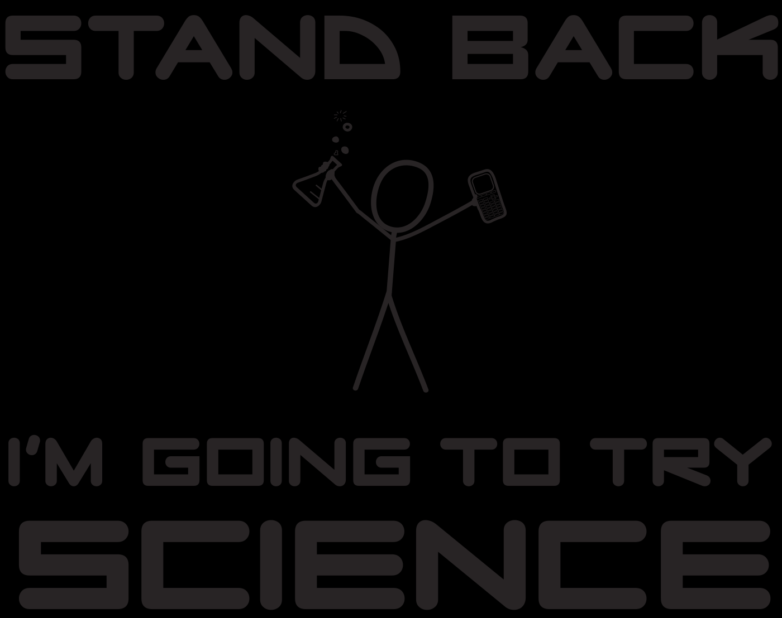
design thinking
COMP3530 - Systems Engineering for Software Engineers | Week 3 | Design thinking and human-centred co-design by Steph Mellor
Notes:
So, in essence, design thinking is a little like science: it’s not a thing you have, but a thing you do.
You can think of design thinking as a method of inquiry, an approach, a mindset or a philosophy that – appropriately applied – can be very useful in helping to understand and respond to challenges. Especially social, human, experiential or complex challenges.

Slide 4
To be human-centred is to look at complex things from the perspective of the people who will use or be affected by them.
What is human-centred?
A human-centred approach urges explorative and evaluative research, to build understanding and empathy.
COMP3530 - Systems Engineering for Software Engineers | Week 3 | Design thinking and human-centred design by Steph Mellor
Notes:
Before we go further into how a design thinking approach works or how you might apply it, let’s unpack a couple of key elements that are implicit and critical to a design thinking approach, but may not be immediately obvious.
Human centred (this slide)
What do you think ‘human’ or ‘user-centred’ means?
Explain using slide text as guide.

Slide 5
Co-design is about recognising that no one person or group of people has the whole picture.
What is “co-design”?
It’s about bringing many voices and perspectives together, and harnessing them in pursuit of a shared outcome.
COMP3530 - Systems Engineering for Software Engineers | Week 3 | Design thinking and human-centred design by Steph Mellor
Notes:
Co-design (this slide)
Who has heard of co-design?
Who feels they understand what it means or have had a chance to practice it?
Explain using slide text as guide.

Slide 6
Society relies on many complex systems of interacting technology, people, processes, laws and other elements. Examples of such systems include air transport, telecommunications and energy supply.
Systems Engineering is a holistic, multi-disciplinary and well established approach to the engineering of these complex systems.
Because software is a critical component of such systems, Software Engineers will often work in Systems Engineering teams.
Why should you care?
COMP3530 - Systems Engineering for Software Engineers | Week 3 | Design thinking and human-centred design by Steph Mellor
Notes:
So why should you care about design thinking in your line of work?
Who recognises this quote? Where is it from? (the COMP3530 course outline / website / description)
What is the point of software that is functional or code that is elegant if no one likes or uses your product…?
Without a human-centred design thinking approach…
Wasted investment
It’s a theoretical win – delivers on requirements or specs, but a shitty experience = does not achieve real / practical outcomes
These days, you can be a coder, a developer, an analyst… but to truly excel and generate real change, you will need to understand design and its value.
Upon completion of this course, the student will be able to:
describe the holistic and multi-disciplinary nature of complex engineering projects
describe the Systems Engineering life-cycle
identify and explain the activities involved in each phase of the Systems Engineering life-cycle
explain the role of Software Engineering within the broader context of Systems Engineering
Students will also improve their:
ability to understand and solve complex and ill-defined problems
ability to communicate with the multi-disciplinary engineering team and the community at large
understanding of and commitment to ethical and professional responsibilities,
ability to function as an individual and as a team leader and member in multi-disciplinary and multi-cultural teams

Slide 7
What does it look like?
DIVERGE
CONVERGE
COMP3530 - Systems Engineering for Software Engineers | Week 3 | Design thinking and human-centred design by Steph Mellor
Notes:
Typically, it looks like this:
Divergence / exploration / gathering / understanding → everything on the table, followed by
Convergence / lensing / weeding out / testing and refining → taking things off the table for good, tested, evidence-based reasons to reach a viable, narrower conclusion or solution
Iteration, validation and refinement in the middle of each part
You can have chains of this process which can represent stages of a project or a string of related projects or endeavours
Design thinking process is characterised by discrete start and stop points = decision points, go/no-go, scalability and agility
You can have nested design processes (e.g. diverge and converge on research insights, within a broader design project)

Slide 8
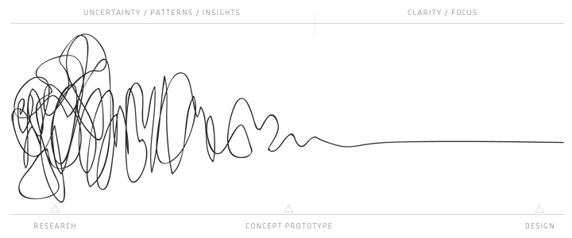
$*&$@#
Aha….
Aw yea!
What does it feel like?
O,,o
COMP3530 - Systems Engineering for Software Engineers | Week 3 | Design thinking and human-centred design by Steph Mellor
Notes:
Design thinking is about making sense of complexity to reach a point of clarity
It is messy and uncomfortable.
Be aware of that, feel the discomfort and learn to lean into it, get used to it, embrace it and leverage it.
Trust the process and encourage those around you to trust it and go with it too.
Remember that design thinking is similar to science: we don’t know the answers or what we may find, but we have a process to reveal them. If you follow it with discipline and the right mindset – curiousity, check your assumptions, embrace discomfort, murder your darlings, etc., you will get there.

Slide 9
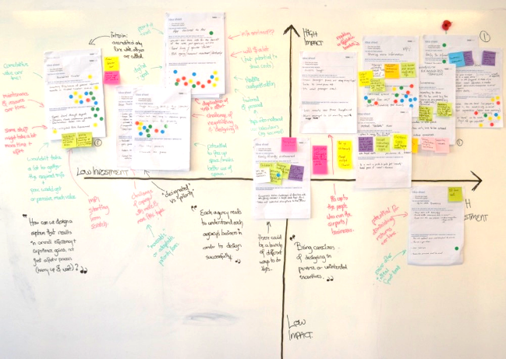
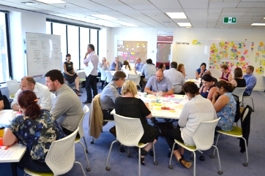
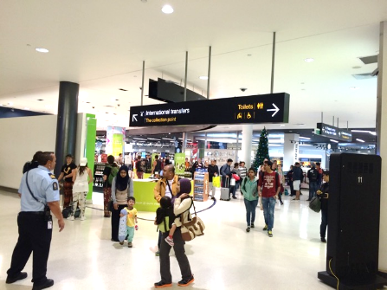
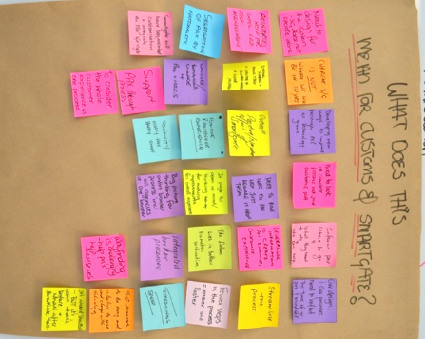
How to play?
COMP3530 - Systems Engineering for Software Engineers | Week 3 | Design thinking and human-centred design by Steph Mellor
Notes:
Run through a high-level overview of ThinkPlace’s design thinking approach to give them an idea / example of how a design thinking approach or project could run in real life + some examples of projects or solutions we have delivered using our approach.
Remind them that the end / conclusion of a design thinking process may not be the end / conclusion or solution to the whole problem: it may reveal information, inform a decision to proceed or not, indicate the direction or solutions that could be worth pursuing or represent a pilot / draft / initial findings. As long as they have followed a robust-enough design thinking process, they will have discovered something useful or valuable.
Again: be prepared to murder your darlings. The ‘answer’ may not be the one you were looking for or expecting. Ignore the findings or outcomes of a design thinking process at your, your team’s or your project’s peril.

Slide 10

OBJECTION!
(or, common challenges in taking a design thinking approach)
COMP3530 - Systems Engineering for Software Engineers | Week 3 | Design thinking and human-centred design by Steph Mellor
Notes:
When you do design thinking, you will encounter resistance:
People who have not come across it
People who don’t like it
People who don’t get it
IT / software dev / engineering folks can often struggle the most, because we are trained to think about function rather than experience a lot of the time. We are often trained to think about the product more than the user. We work to budgets and project schedules and KPIs. And we are makers, so we get invested in the things we make and may struggle to be open to evidence-based or human-centred criticism.
Don’t be that guy. Or girl. Get on board, and teach others how to get on board with you.
Here’s a few common barriers to design thinking that we encounter, and some tips for how to dissolve them.

Slide 11

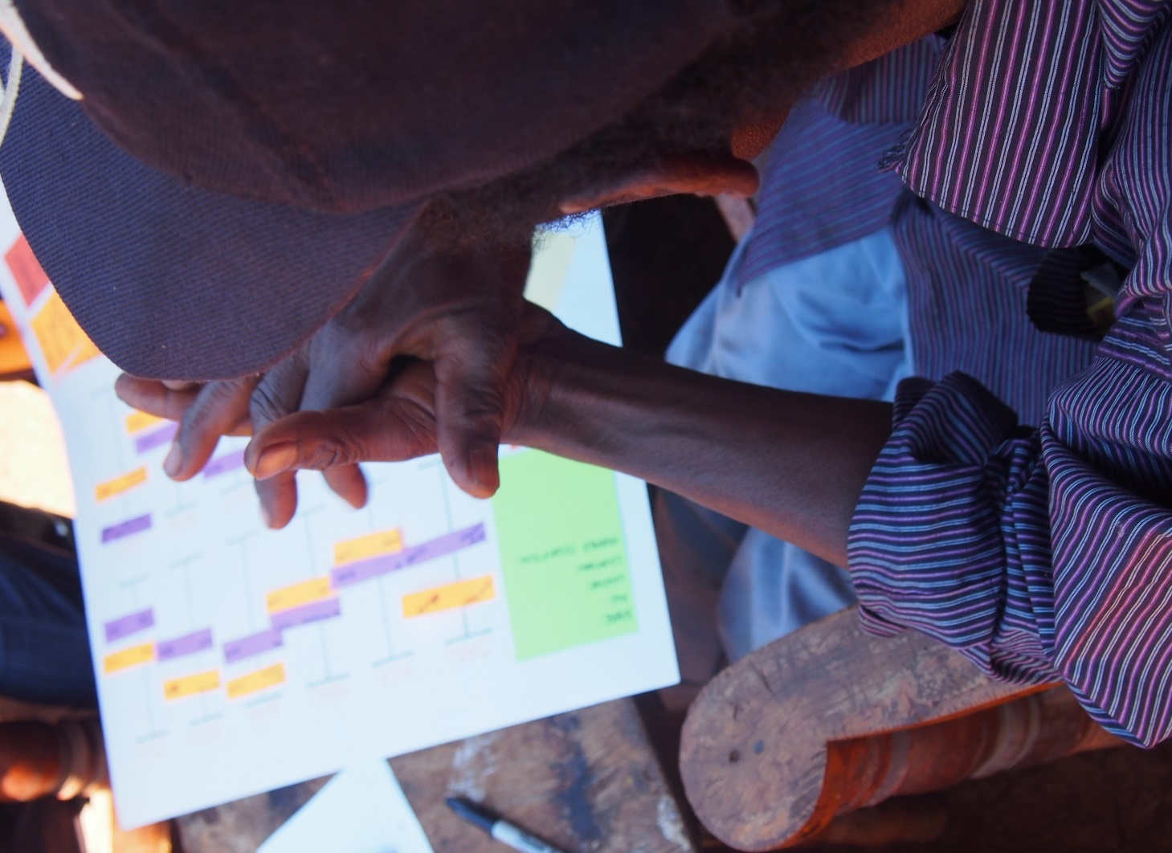
But we can’t, like, actually *talk* to people…
COMP3530 - Systems Engineering for Software Engineers | Week 3 | Design thinking and human-centred design by Steph Mellor
Notes:
Barrier 1: “But you can’t actually, like, talk to people / customers / users / the public.” or “Our customers won’t talk to you.” or “We already know what users need/want/do”
How many services or apps or tools do you use that you weren’t involved in making?
How many times have you thought “f*ck, that’s stupid – why didn’t they just…?”
Many businesses do customer engagement well, as their success is bound up in the customer experience and customer satisfaction. However, many organisations struggle, including governments who have not traditionally had a customer service or user-centred mindset in their policy or service implementation.
When we say to our clients and partners that organisations often have this idea that they can design effective and positive services / interfaces / experiences / systems / strategies / products / communications without actually talking to the people for whom those things are being designed, people laugh. Because it sounds ridiculous to state it plainly like that.
But many do it. You’ve probably done it. I have too.
Here’s a secret: there are very few humans in the history of the world who have not wanted to be heard or will not respond to their opinion or experience being genuinely and openly sought and listened to. People will talk to you if you ask them nicely and are prepared to listen.
A corollary to “you can’t talk to real users” is “we don’t need to talk to them; we already know”. No. You don’t. And that’s just patronising. Check your assumptions. Even if you did research last year, talk to people again. You don’t know and designing on the assumption that you do is designing with YOU as the user – for YOUR knowledge / experience / perspective, not theirs. Honour your users and you will get a better result every time.

Slide 12
Desirable
Viable
Here be powerful
ideas
Possible
COMP3530 - Systems Engineering for Software Engineers | Week 3 | Design thinking and human-centred design by Steph Mellor
Notes:
Barrier 2: the viability versus blue sky freak-out
You will always encounter people who are primarily concerned with feasibility and constraints. That’s ok. Those people are not just cynics and downers and naysayers – they may be those things too, but you do yourself, them and everyone involved a disservice to dismiss their voices. They are important for a robust design thinking process.
However, it’s important not to start from a position of constraint. It’s very difficult to be innovative or experimental or creative if you start from a position of constraint. Design-thinking is user-centred – start from a position of desirability and possibility: what do we want to deliver, and what could we deliver if there were no constraints?
Then you can layer in viability as you converge on the best solution, decision or outcome. You may not be able to do thing X that is possible and desirable, but you may be able to approximate a similar experience by doing thing Y that is cheaper / faster / partway there. You may never have thought of Y if you had started from a place where X was never on the table.
Yes to viability. After you have explored desirability and possibility.

Slide 13
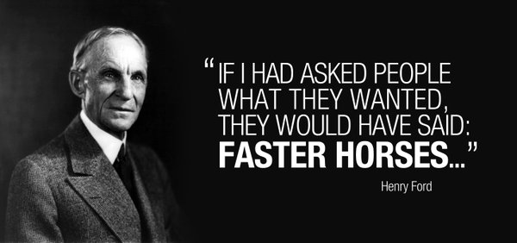
COMP3530 - Systems Engineering for Software Engineers | Week 3 | Design thinking and human-centred design by Steph Mellor
Notes:
Barrier 3: User-centred design is not user-led design.
The user is not the designer. You are the designer.
The user is everyone in the system, not just an end-user or a customer
The user is one of many voices in a design thinking process – others include strategy, expertise and delivery
There is a difference between learning and designing from an understanding of the experience, needs, preferences and expectations of the user, and designing to deliver on every user desire or allowing users to dictate the design.
Design thinking is collaborative. It relies on a diversity of perspectives to balance and guide the conversation or process to an optimal solution for all. As a design thinker, your job is to broker the different perspectives who have a stake in what you are designing in order to find the best outcomes and solutions that meet majority needs, resolve the biggest pain points or present the greatest value. You need to listen to what is being expressed and seek the meaning that lies beneath it. Honour the user voice and deliver a better experience without being slavish or surface-level about it.
Remember Henry Ford and ask yourself: is the solution to figure out how to make horses faster? Or how to get people from A to B faster?

Slide 14
me: steph@thinkplace.com.au
us: people@thinkplace.com.au
#protip: I’m more open to bribery.
Notes:
Questions?

